Slide 1
Design with Intent
101 patterns for influencing behaviour through design
1.0
Dan Lockton with
David Harrison & Neville A. Stanton
Requisite Variety

Slide 2
Design with Intent:
101 patterns for influencing behaviour through design Dan Lockton with David Harrison & Neville A. Stanton ISBN 978-0-9565421-0-6 (printed cards); ISBN 978-0-9565421-1-3 (eBook). First published
online April 2010; printed version May 2010. Minor revisions 2011, 2012.
This is a non-commercial work, with printed editions sold to cover costs only.
Published by Equifine, an imprint of Requisite Variety, St Margaret’s, Middlesex, UK
Dan Lockton specialises in interaction design for behaviour change, persuasive
technology and sustainable design. He does consultancy, workshop facilitation and research as Requisite Variety, and is currently a research fellow at WMG, University of Warwick and a research assistant at Brunel University in London, working with startup CarbonCulture on reducing workplace energy use through user-centred design for behaviour change. He is also a visiting practitioner at Central Saint Martins School of Art & Design.
With the exception of certain images, the proprietors and nature of which are identified on the introduction card for each lens, this work is licensed by Dan Lockton under the Creative Commons Attribution-Noncommercial-Share Alike 3.0 licence, available at: creativecommons.org/licenses/by-nc-sa/3.0 or by writing to: Creative Commons, 171 2nd Street, Suite 300, San Francisco, CA 94105, USA.
This is Tiresias Infofont, made available under the GNU General Public Licence by the RNIB, and available from tiresias.org
Dan has a BSc in Industrial Design Engin- eering from Brunel’s former Runnymede design school, a Cambridge-MIT Institute Master’s in Technology Policy from the University of Cambridge’s Judge Institute, and is completing his PhD at Brunel currently. Before returning to Brunel, he worked on a range of design and product development projects, including ultra-light bike design for Sinclair Research.
Since 2005, the Design with Intent blog (danlockton.co.uk), originally titled Architectures of Control in Design, has looked at the interface between designed
All trademarks depicted incidentally in this work remain the property of their proprietors and are used here solely for illustration and review purposes
Many thanks to everyone who has helped with the development of the Design with Intent toolkit, including taking part in workshops, commenting on the research as it has progressed, and reading the blog. Thanks too to the Ormsby
systems and human behaviour.
requisitevariety.co.uk
dan@danlockton.co.uk
Trust and the Thomas Gerald Gray Charitable Trust who have enabled me to pursue my PhD at Brunel. And thank you to Harriet, for her endless patience.
Requisite Variety
@danlockton
Professor David Harrison is Head of Design Research at Brunel University, and specialises in reducing the environmental impact of technology via novel manufactur- ing methods and design process innovation.
Professor Neville A. Stanton is Chair of Human Factors in Transport at the University of Southampton, and is an internationally recognised expert in ergonomics and human performance in technological domains.
You can download these cards, free of charge, let us know how you used them, and complete a survey to improve future versions, at:
designwithintent.co.uk

Slide 3
Introduction How to use the cards
All design influences our behaviour, but as designers we don’t always consciously consider the power this gives us to help people (and, sometimes, to manipulate them). Whether we mean to do it or not, it's going to happen, so we might as well get good at it — and understand when it’s being done to us. There’s a huge opportunity for design for behaviour change to address social and environmental issues, but as yet little in the way of a guide for designers and other stakeholders, bringing together knowledge from different disciplines, and drawing parallels which can allow concepts to be transposed.
Each pattern / gambit is phrased as a question — a provocation to invite discussion about the behaviour change question or brief you’re considering*. The landscape format means it is easier for two people to look at a card together.
Lens-by-lens
Lay out all the cards, grouped by lens, and
The Design with Intent toolkit (these cards and the accompanying wiki, at http://designwithintent.co.uk) aims to make a start on this task.
I use Design with Intent to mean design that’s intended to influence or result in certain user
go through each lens seeing whether the questions inspire any concepts for addressing your problem. In
S groups it often works well for one
A
behaviour — it’s an attempt to describe systems (products, services, interfaces, environments) that have been strategically designed with the intent to influence how people use them. The toolkit has evolved from an attempt at a very structured method for prescribing particular design features, to a loose concept generation tool, provoking design ideas by asking questions and giving examples of particular principles in action. This evolution is a result of running
or two people to take a lens each and discuss together, then all ‘report back’ to everyone else. Analyse existing idea spaces Try using the cards to draw
out some of the
L
I
P
workshops with designers and students, and seeing what works and what doesn’t. But the E behaviour-influencing
M
process isn’t finished, and your feedback on how you’ve used these cards, and how to improve them, is very much appreciated — please see the card ‘How you can help’.
principles behind products, services or environments you‘re familiar with, and see if
there are gaps or opportunities to
Structure of the toolkit
The cards are grouped into eight ‘lenses’ representing different disciplinary ‘worldviews’ or fields of research. Each lens has an introduction card which explains a bit more of the background. It’s a loose taxonomy and many cards would fit happily in other lenses: the point really is to encourage designers to think about behaviour change from different perspectives.
Equally, the dividing lines between lenses are relatively fuzzy: if arranged as a series of segments as shown here, moving from each lens to the next clockwise or anti-clockwise only requires a small shift in thinking. The
explore further. Printing the cards onto sticker paper can be useful here for ‘annotating’ real items. Models of the user
Works best with three or more people. Using the ‘Pinball’, ‘Shortcut’ and ‘Thoughtful’ cards, each person should try to generate ideas sticking to one of the models, then explain (and defend) them to the rest of the group.
Target behaviours
Using the ‘Target behaviours’ card as a starting point,
try to frame your problem in terms of a target
Environment
‘environment‘ and ‘mind’ labels are tentative but reflect the general focus of the lenses, with those at the opposite corners involving most overlap.
Is this a design pattern library? Sort of. The idea of design patterns, drawn from Christopher Alexander's work in architecture, has been adopted throughout programming and human-computer interaction. This latter context has influenced the form of DwI, with a large dose of both TRIZ and IDEO’s Method Cards. However, the DwI cards are more like provocations — ‘Can you do this with your design?’ — than the established ‘Use this when...’-style of the design pattern structure. At present we just don't have enough evidence about what works and what doesn't in different situations to be able to be that specific, although in time this will change.
Bryan Lawson has used the term ‘gambit’ to describe the ‘repertoire of
tricks’ that experienced designers can bring to bear on a problem; the key is
Errorproofing Interaction
behaviour, and keeping this is mind, look at the cards suggested as most applicable.
Random pairings
Pick two cards at random, perhaps from different
lenses, and think about the possibilities of applying the ideas to your problem, both individually and together. Weekly idea
101 cards means that every week for two years you could have a new card ‘on show’ as a talking point in the office to inspire creative thinking**.
Your own way
If you‘ve found your own way to make use of the cards, let everyone know! Write about it, or email me: dan@danlockton.co.uk
E I
A L
S P
M C
Architectural Ludic
Security Perceptual
Machiavellian
Cognitive
Mind
pattern recognition of the problem and quick matching to possible moves to address it, and is is hoped that the DwI cards fit this approach. So, for the moment, I'm using both ‘gambit’ and ‘pattern’ to describe each DwI card.
*I’m grateful to Nedra Weinreich for suggesting the ‘question’ approach. **Hat tip to Zoe Stanton of Uscreates for this idea.
The eight lenses of the toolkit

Slide 4
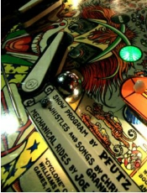
Modelling users: Pinballs
In Designing for Interaction, Dan Saffer notes “designers have to give up control (or, really, the myth of control) when designing a service process.” Nevertheless, many products, services and environments have aspects where a degree of control is desired, often for safety or security reasons. If a bank has a row of ATMs, it doesn’t want customers at adjacent machines to stand too close together, so it spaces them far enough apart for this not to happen: the actual affordances of the system are designed so that only certain behaviours occur. In 2009 Nepal‘s Tribhuvan Airport issued staff with trousers without pockets, to reduce bribery by making it harder to hide cash.
This approach models users as ‘pinballs’, simple components of your system, to be shunted and pushed and pulled around by what you design, whether it’s physical, digital or service architecture. This view basically doesn’t assume that the user thinks at all, beyond basic reflex responses: there is no requirement for understanding. The interlock on a microwave door prevents using the oven with the door open, yet does not try to educate users as to why it is safer. It just silently structures behaviour: users follow the designers’ behaviour specification without necessarily being aware of it.
This view can lead to poor user experience, when the priorities of the designer and users conflict. Disabling the fast-forward button on your DVD player, to force you to sit through trailers and copyright threats, provokes significant discontent. However, where interests align, better experience can result. A hospital which fits medical gas bottles and hoses with errorproofed ‘indexed pin’ connectors — keyed to fit together only in the right combinations — is restricting nurses‘ behaviour, but making the job easier and providing a safer patient experience. So, the pinball approach is not always as user-unfriendly as it might initially seem, but does risk challenging people’s autonomy, and potentially reducing their engagement in the process.
Some ‘pinball’ patterns These are not definitive by any means.
Note that only some lenses are included.
Converging & diverging
Conveyor belts Feature deletion Hiding things Positioning Roadblock
Segmentation & spacing
Choice editing Interlock
Matched affordances Task lock-in/out Bundling
Degrading performance Forced dichotomy Coercive atmospherics Threat of injury
Threat to property What you can do What you have What you know What you’ve done Where you are
Who or what you are
Photograph by ktpupp on Flickr, CC-BY-NC licensed,
http://www.flickr.com/photos/ktpupp/485265735

Slide 5
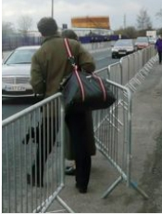
Modelling users: Shortcuts
While people are not fully predictable, there is enough psychological evidence that we are, at least, predictably irrational (Dan Ariely’s term). There are recurring patterns of decision-making heuristics and biases, and designers with an understanding of these have a powerful tool for influencing behaviour. In an economic context, this is the premise behind Richard Thaler and Cass Sunstein's bestseller Nudge, but designers can apply many of the same insights, with the benefit of a wealth of user-centred research methods to test our assumptions.
People take shortcuts. We make decisions based on how choices are presented to us, and can’t devote the same mental effort to engage with every decision (we satisfice, to use Herbert Simon’s term). If something is the default, whether print quality or presumed consent for organ donation, most people probably stick with it.
Individually these acts might not bear analytical scrutiny – and none of us acts like this all the time – but shortcut decisions do determine how many people behave when interacting with systems, whether products,
Some ‘shortcut’ patterns These are not definitive by any means.
services or environments. We can design choice architecture to help people navigate the options available in a mutually beneficial way: e.g., if your research shows that your customers make purchasing decisions based purely on price, it makes sense to present your choices in a way which makes it easy to determine which is cheapest. On the other
hand, we can also use design to help users overcome the biases which are preventing them getting the best result, e.g. re-framing food choices to make healthier options more appealing.
Of course, modelling users like this risks the designer becoming part of a ‘nanny state’, making moral decisions about ‘what’s best’ for users. To some extent this is inevitable: we just have to be more mindful of how the choices we make affect the lives of others, and, perhaps, bear “first, do no harm” in mind when planning to influence behaviour.
Mazes Simplicity Defaults Opt-outs Portions
Partial completion
Tunnelling &
wizards
Make it a meme Rewards Unpredictable reinforcement Colour associations Contrast
Implied sequences Mood
Perceived affordances Prominence Proximity &
grouping
Similarity
Decoys
Do as you’re told
Expert choice Framing Scarcity
Social proof Anchoring Serving suggestion Style obsolescence Worry resolution
Photograph by
Dan Lockton

Slide 6
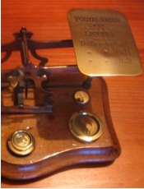
Modelling users: Thoughtful
This is the most optimistic view of ‘what users are like’: engaged, motivated, thoughtful people who will take every opportunity to learn more about the world around them and their impacts on it. Thoughtful users are assumed to think about what they are doing, and why, and change their attitudes and behaviour in response to reasoned arguments, weight of evidence, education and persuasive rhetoric. If you model your users this way, you’ll be looking to provide them with reasons why some behaviours are ‘better’ than others, maybe motivating them to change their attitudes about a subject as a precursor to changing their behaviour mindfully. From a design perspective, you‘ll probably be giving your system plenty of information displays and feedback which allow users to explore the implications of what they’re doing, and understand the world around them better.
Most of us like to model ourselves as thoughtful users, even though we know (if we’re honest) that we don’t always fit the model. It’s probably the same with most people: so knowing when it’s appropriate to assume that users are being mindful of their behaviour, and when they’re not, will be important for the ’success’ of a design.
It may be that the best (and least naïve) way to look at this is to appreciate that designers working on behaviour change have the opportunity to move people from a less engaged (pinball or shortcut) mindset, towards a more reflective, motivated, thoughtful relationship with a product, service or environment. Many of the patterns which I’ve listed here as being relevant to the ‘thoughtful’ model are really about trying to get people involved or interested in their own effects on a system, rather than assuming that everyone already cares.
Some ‘thoughtful’ patterns These are not definitive by any means.
Conditional warnings
Did you mean? Are you sure?
Feedback through form Kairos
Peer feedback Real-time feedback
Simulation & feedforward Summary feedback
Leave gaps to fill Role-playing Storytelling Nakedness Watermarking
Emotional engagement Provoke empathy
I cut, you choose Surveillance Peerveillance Sousveillance
Photograph by Esther Dyson on Flickr, CC-BY-NC licensed,
http://www.flickr.com/photos/edyson/87566058

Slide 7
Target behaviours
These are an attempt to introduce a more formal ‘prescription’ mode to the DwI toolkit: matching patterns to particular kinds of behaviour change. Inspired by the TRIZ problem-solving method, the target behaviours are ‘ideal’ intended outcomes: particular behaviours which a designer (or client) wants to achieve through design. They’re an abstract classification for behaviours, expressed as goals — the 11 example target behaviours in the table below have been identified by deconstructing real situations, but this is only scratching the surface of what could be done with a more wide-ranging analysis.
I’m not entirely convinced that this is a way forward for DwI, primarily because in the workshop trials I’ve run, designers really don’t seem to enjoy using this kind of prescription method, at least in comparison
to using the cards for free-form inspiration. But I felt I should include it in this pack anyway. At http://behaviorgrid.org, BJ Fogg has a different take on target behaviours, based on schedules of occurrence, which is sufficiently general to be more scaleable than those I’ve outlined here.
User–system interaction: influencing interactions between a user and the system
S1 The user follows a process or path, doing things in a sequence chosen by the designer
Examples Some relevant patterns
Customer places order via website without missing out any steps
Mazes, Positioning, Interlock, Tunnelling & wizards, Implied sequences, Serving suggestion
S2 The user follows a process or path that's optimised for those particular circumstances
User only spends as much time as really needed in the shower
Conditional warnings, Did you mean?, Are you sure? Task lock-in/out, Tailoring, Possibility trees
S3 Decision among alternatives: a user's choice is guided
Diners choose healthier meal in office canteen
Defaults, Opt-outs, Kairos, Simulation & feedforward, Colour associations, Prominence, Proximity &
grouping, Similarity, Decoys, Do as you're told, Expert choice, Framing, Scarcity, Anchoring, Forced dichotomy
S4 Only certain users/groups of users can use something
Only users who know PIN can access bank account via ATM
Coercive atmospherics, Who or what you are, What you know, What you have
S5 Only users already behaving in a certain way get to use something
If a driver's travelling below the speed limit, the next set of traffic lights turn green, otherwise they stay red
Degrading performance, Threat of injury, Threat to property, What you can do, What you've done
S6 No users can use something in a particular way, regardless of who they are or what they've done before
Park bench fitted with central armrest to prevent anyone lying down
Feature deletion, Hiding things, Choice editing, Matched affordances, Coercive atmospherics
S7 Users only get functionality when environmental criteria are satisfied
Office lighting cannot be switched on if ambient daylight adequate
Interlock, Where you are
User–user interaction: influencing interaction between users and other users, mediated by the system
U1 Multiple users are kept separate so they don't affect each other while using a system
Examples Some relevant patterns
Traffic follows one-way system into/out of car park
Material properties, Converging & diverging
U2 Users (and groups of users) do interact with, and affect each other while using a system
Staff from different departments mix socially in a building's atrium
Converging & diverging, Make it a meme, Provoke empathy, Reciprocation, Social proof, Peerveillance
U3 Users can't block or dominate a system to the exclusion of others
Wide pedestrian concourses prevent groups blocking passage for others
Segmentation & spacing, Peer feedback
U4 Controlled rate of flow or passage of users Visitors to popular museum exhibit routed
past it slowly on moving walkway
Conveyor belts, Roadblock, Slow/no response

Slide 8
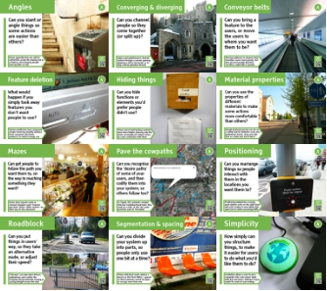
Architectural Lens
The Architectural Lens draws on techniques used to influence user behaviour in architecture, urban planning, traffic management and crime prevention through environmental design (see also the Security Lens).
While most techniques have been developed in the built environment, many can also be applied in interaction and product design, even in software or services; they are effectively about using the structure of systems to influence behaviour, while some of the patterns, such as Simplicity, Feature deletion and Hiding things are really fundamental to design itself.
Image for Pave the Cowpaths is a screenshot of an annotated Google Map on Kittelson & Associates' website (http://prj.kittelson.com/tigardtrails).
All other photos by Dan Lockton
For references & further reading, please see 3.ly/archi
A
3.ly/archi

Slide 9
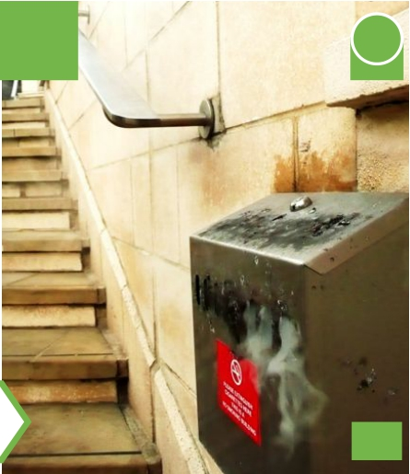
Angles
A
3.ly/Arch
Can you slant or angle things so some actions are easier than others?
Some cigarette bins are sold to authorities using the sloping top as a feature, discouraging people leaving litter on top
Design with Intent

Slide 10
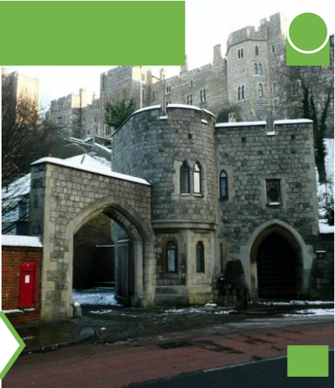
Converging & diverging
ArA 3.ly/Arch
Can you channel people so they come together (or split up)?
Gates (and gatehouses) channel visitors through a narrow opening, allowing a toll to be levied, or to help control potential threats
Design with Intent

Slide 11
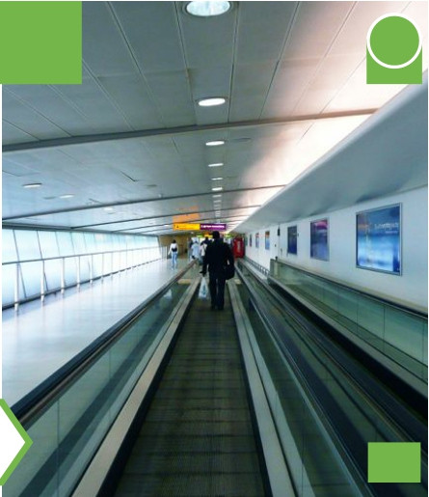
Conveyor belts
ArA 3.ly/Arch
Can you bring a feature to the users, or move the users to where you want them to be?
Moving walkways in airports help travellers move more quickly, but also prevent people blocking corridors, especially in groups
Design with Intent

Slide 12
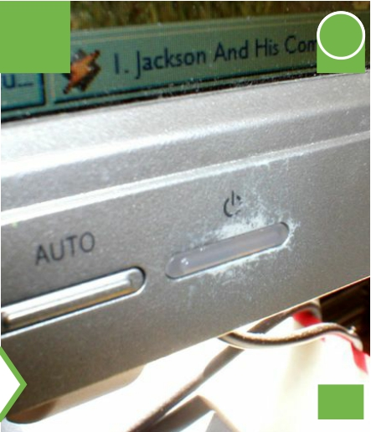
Feature deletion
ArA 3.ly/Arch
What would happen if you simply took away features you don’t want people to use?
Various politicians have proposed simply removing standby buttons from consumer electronic products, to reduce energy use
Design with Intent

Slide 13
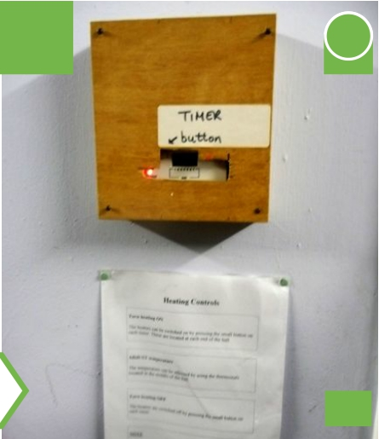
Hiding things
ArA 3.ly/Arch
Can you hide functions or elements you’d prefer people didn’t use?
These church hall heating controls have been hidden (leaving only the timer accessible) to reduce errors by users unfamiliar with them
Design with Intent

Slide 14
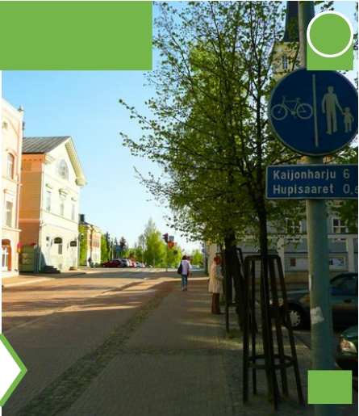
Material properties
ArA 3.ly/Arch
Can you use the properties of different materials to make some actions more comfortable than others?
Rough-textured paving can act as a subtle barrier between cycle and pedestrian tracks: stray over the line on a bike and you’ll feel it
Design with Intent

Slide 15
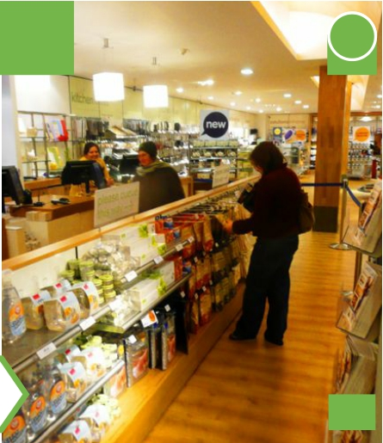
Mazes
ArA 3.ly/Arch
Can get people to follow the path you want them to, on the way to reaching something they want?
Some store layouts route or channel shoppers past ‘impulse purchase’ items—often snacks—on their way to the checkouts
Design with Intent

Slide 16
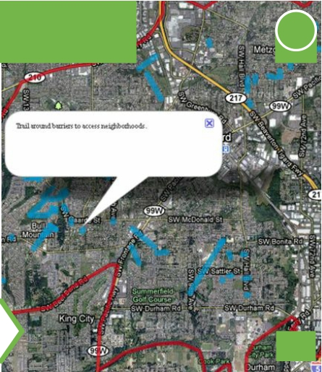
Pave the cowpaths
ArA 3.ly/Arch
Can you recognise the 'desire paths' of some of your users, and then codify them into your system, so others follow too?
In Tigard, OR, residents marked informal ‘neighbourhood trails’ they used on a map, so the city could prioritise ones to ‘formalise’
Design with Intent

Slide 17
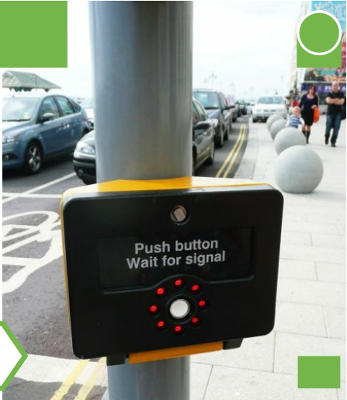
Positioning
ArA 3.ly/Arch
Can you rearrange things so people interact with
them in the locations you want them to?
Positioning pedestrian crossing push-button units on the right-hand side (UK) makes it more likely that users turn to notice oncoming traffic
Design with Intent

Slide 18
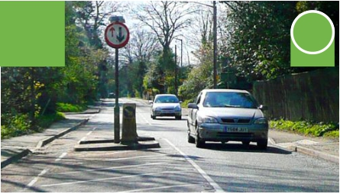
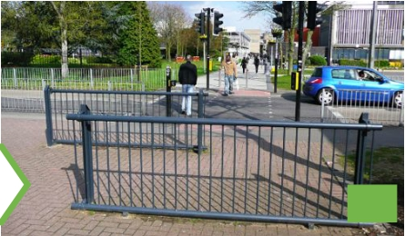
Roadblock
ArA 3.ly/Arch
Can you put things in users’ way, so they take an alternative route, or adjust their speed?
‘Chicanes’ can slow down drivers, pedestrians and cyclists; the crossing chicane prevents running or cyclingstraight across the road
Design with Intent

Slide 19
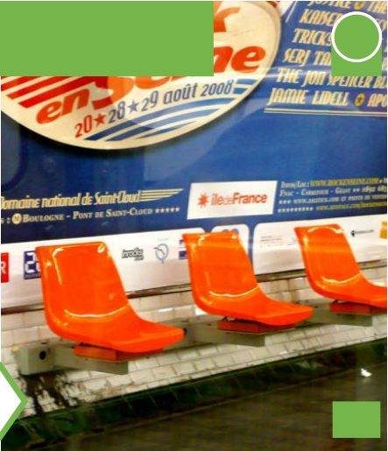
Segmentation & spacing
ArA 3.ly/Arch
Can you divide your system up into parts, so people only use one bit at a time?
These individual seats replace a bench on the Paris Métro – spaced so that someone cannot lie down or occupy more than one
Design with Intent

Slide 20
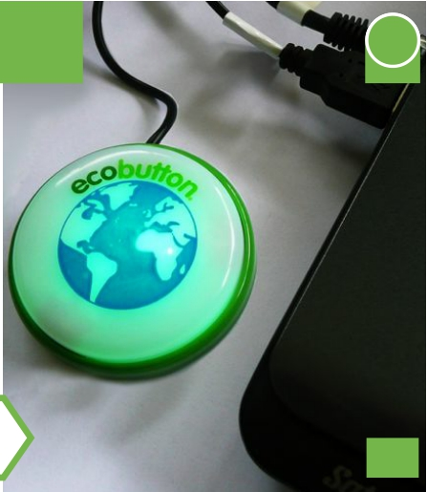
Simplicity
ArA 3.ly/Arch
How simply can you structure things, to make
it easier for users to do what you’d like them to do?
EcoButton allows a user to put a computer into a low-power state with just one press, making it much easier for users to save energy.
Design with Intent

Slide 21
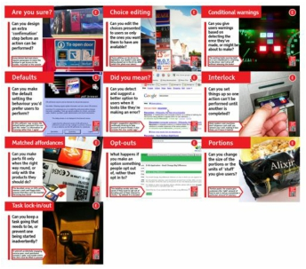
Errorproofing Lens
The Errorproofing Lens treats deviations from the ‘target behaviour’ as ‘errors’ which design can help avoid, either by making it easier for users to work without making errors, or by making errors impossible in the first place. It’s often found in ergonomics, health & safety-related design, medical device design and manufacturing engineering (as poka-yoke): where, as far as possible,
one really doesn’t want errors to occur at all. Much of this builds on Don Norman‘s classic concept of forcing functions and ‘deliberately making things difficult’ as detailed in The Design of Everyday Things.
A key difference between errorproofing and some other views of influencing behaviour is that errorproofing doesn’t care whether or not the user’s attitude changes, as long as the target behaviour is met. Attitude change might be a side-effect, but it is not required.
Images for Defaults, Did you mean? and Opt-outs are screenshots of CIB PDF Brewer software, a Google search for ‘recursion’ and Yorkshire Building Society website respectively. All other photos by Dan Lockton
For references & further reading, please see 3.ly/error
AE
3.ly/error

Slide 22
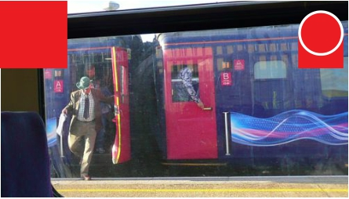
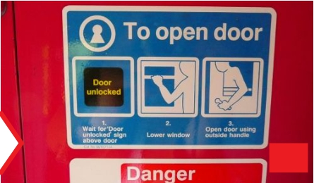
Are you sure?
E
3.ly/Erro
Can you design an extra ‘confirmation’ step before an action can be performed?
Some British Rail train doors require passengers to lower the window to get access to the handle, mounted on the outside
Design with Intent

Slide 23
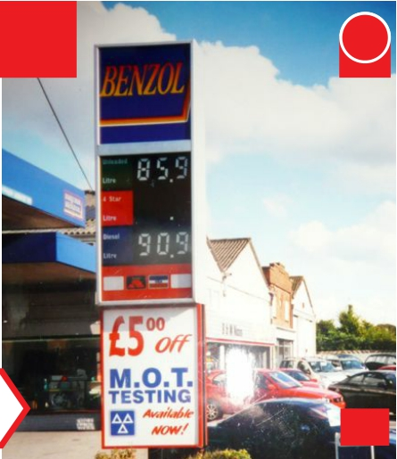
Choice editing
EpE 3.ly/Erro
Can you edit the choices presented to users so only the ones you want them to have are available?
Choice editing can be driven by legislation, e.g. leaded 4-star petrol being phased out in the EU by 2000 (when this photo was taken)
Design with Intent

Slide 24
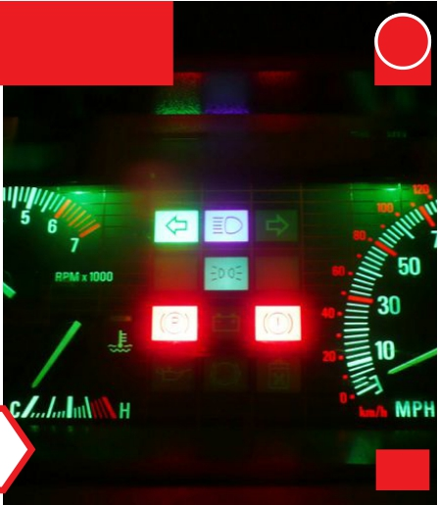
Conditional warnings
EpE 3.ly/Erro
Can you give users warnings based on detecting the error they’ve
made, or might be about to make?
The parking brake warning light on a car’s dashboard is a warning to the driver: don’t drive off without releasing the brake!
Design with Intent

Slide 25
Defaults
EpE 3.ly/Erro
Can you make the default setting the behaviour you’d prefer users to perform?
In this software ‘nag’ screen, the default button (pressed if the user just hits ‘enter’) is information on licensing rather than ‘I agree’
Design with Intent

Slide 26
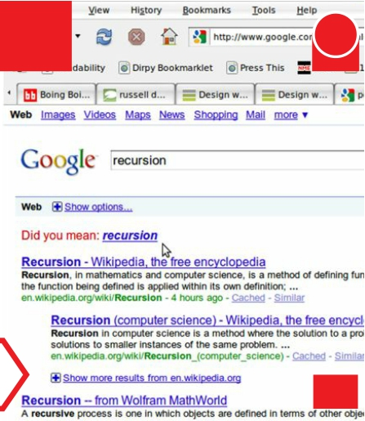
Did you mean?
EpE 3.ly/Erro
Can you detect and suggest a better option to users when it looks like they’re making an error?
Google’s suggestion algorithm is continually evolving to take account of search trends; it also includes this nice ‘easter egg’!
Design with Intent

Slide 27
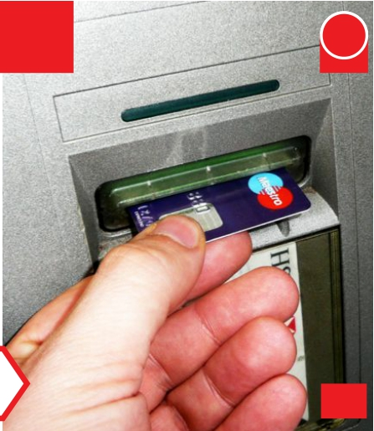
Interlock
EpE 3.ly/Erro
Can you set things up so one action can’t be performed until another is completed?
Most modern cash machines don’t dispense cash until you remove your card, making it less likely you’ll leave it behind
Design with Intent

Slide 28
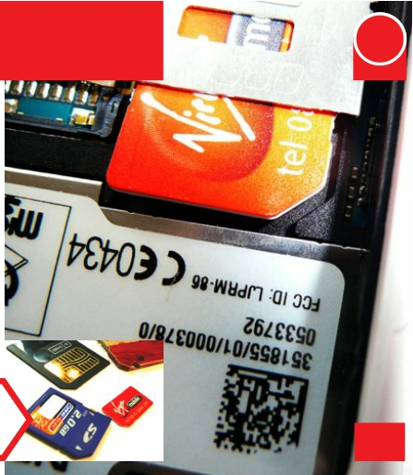
Matched affordances
EpE 3.ly/Erro
Can you make parts fit only when the right way round, or only with the products they should do?
The bevelled corner on SIM cards, memory cards and floppy disks ensures that they can’t be inserted the wrong way round
Design with Intent

Slide 29
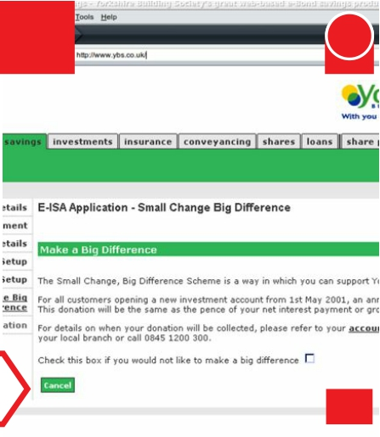
Opt-outs
EpE 3.ly/Erro
What happens if you make an option something people opt out of, rather than opt in to?
This building society asks new savers if they want to opt out of donating part of their interest to charity – by default it is donated
Design with Intent

Slide 30
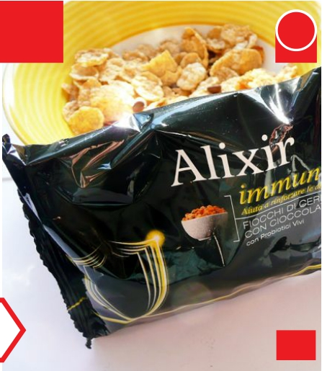
Portions
EpE 3.ly/Erro
Can you change the size of the portions or the units of ‘stuff’ you give users?
‘Portion packs’ for snacks give customers the ‘right’ amount of food to eat in one go (sometimes a particular amount of calories)
Design with Intent

Slide 31
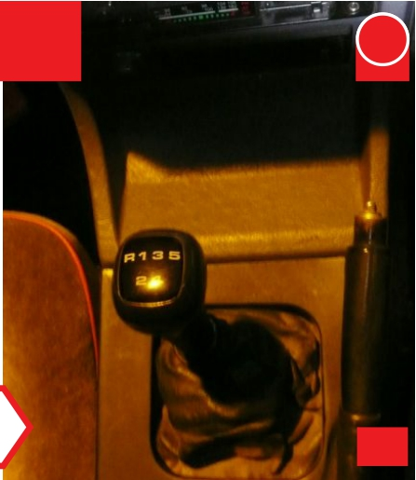
Task lock-in/out
EpE 3.ly/Erro
Can you keep a task going that needs to be, or prevent one being started inadvertently?
To prevent accidentally engaging reverse gear, most gearboxes include a ‘gate’ over/under which the stick must be lifted or pressed
Design with Intent

Slide 32
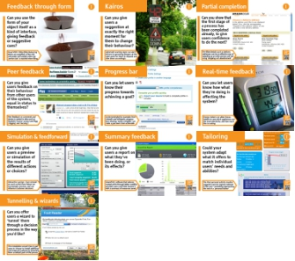
Interaction Lens
All the patterns are really about interaction design in one form or another, but the Interaction Lens brings together some of the most common design elements of interfaces where users' interactions with the system affect how their behaviour is influenced. So there are some core Human- Computer Interaction patterns here, such as kinds of feedback, progress bars, and previews, and some currently less-used such as feedforward. This lens also includes patterns from the growing field of Persuasive Technology, where computers and phones influence behaviour through contextual information and guidance. Among these are kairos, tailoring and tunnelling, identified in BJ Fogg's seminal book Persuasive Technology: Using Computers to Change What We Think and Do.
AEI
3.ly/inter
Images for Feedback through form, Summary feedback and Tailoring are taken from promotional videos/demos by Royal VKB, GreenPrint and Pam, available at http://shop.royalvkb.com/shopexd.asp?id=423&menu=2, http://www.printgreener.com &
http://www.pam.com/indexc.php?demo=1&f=1&ClientTZ=-60
Images for Partial completion, Peer feedback, Progress bar, Simulation &
feedforward and Tunnelling & wizards are screenshots of Amazon, Slashdot, Digg, LinkedIn, Wikipedia, Yahoo! savings calculator & Foxit PDF reader. Other photos by Dan Lockton.
For references & further reading, please see 3.ly/inter

Slide 33
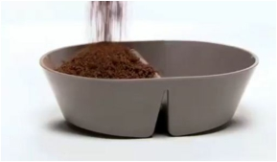
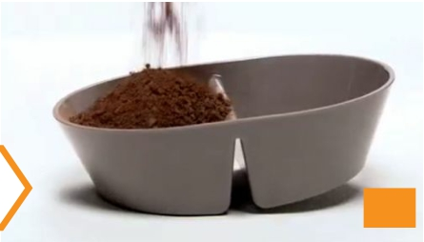
Feedback through form
InI 3.ly/Inte
Can you use the form of your object itself as a kind of interface, giving feedback or suggestive cues?
Royal VKB’s 100g/250g Balancing Bowls are weighted so they tilt noticeably and audibly when the ‘portion size’ is reached when filling
Design with Intent

Slide 34
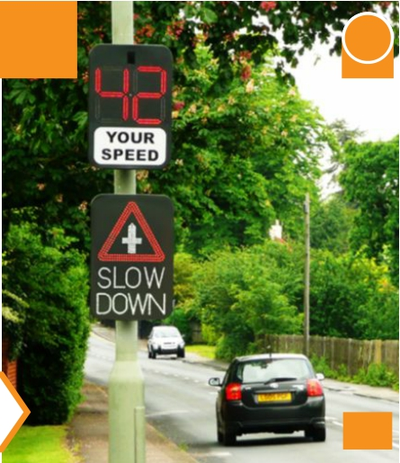
Kairos
InI 3.ly/Inte
Can you give users a suggestion at exactly the right moment for them to change their behaviour?
Automatic warning signs can alert drivers to upcoming dangers at the right point for them to respond and slow down accordingly
Design with Intent

Slide 35
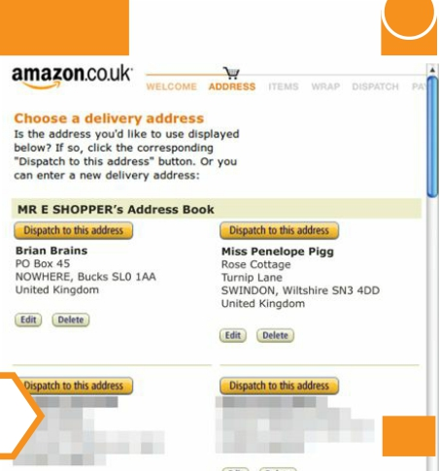
Partial completion
InI 3.ly/Inte
Can you show that the first stage of
a process has been completed already, to give users confidence to do the next?
Pre-filled details such as delivery addresses can be an effective way of speeding up an order process and red- ucing ‘shopping cart abandonment’
Design with Intent

Slide 36
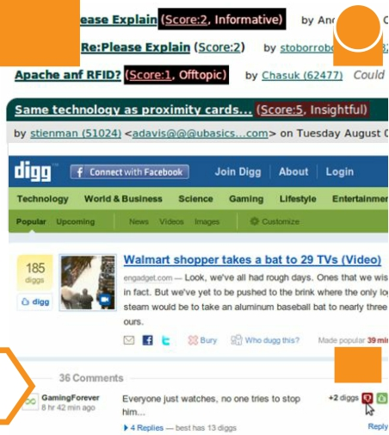
Peer feedback
InI 3.ly/Inte
Can you give
users feedback on their behaviour from other users of the system, equal in status to themselves?
Peer feedback on comments and stories is central to sites such as Slashdot (‘karma’ scores) and Digg (’digging’ and ‘burying’)
Design with Intent

Slide 37
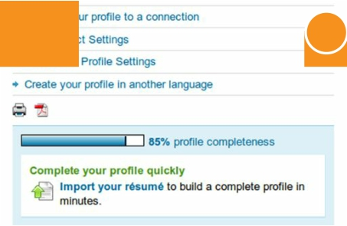
Progress bar
InI 3.ly/Inte
Can you let users know their progress towards achieving a goal?
As demonstrated by examples from LinkedIn and Wikipedia, progress bars showing ‘nearly complete’ can make a goal seem more achievable
Design with Intent

Slide 38
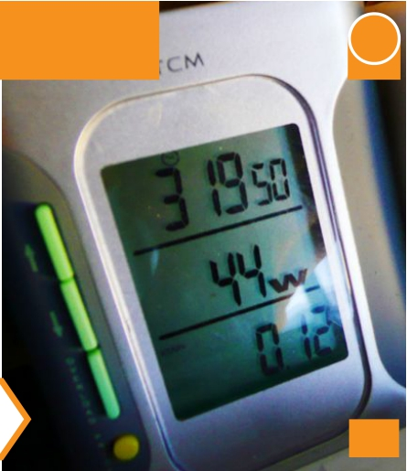
Real-time feedback
I
3.ly/Inte
Can you let users know how what they’re doing is affecting the system?
Energy meters can allow house- holders to see which appliances use the most electricity, and how much this is costing
Design with Intent

Slide 39
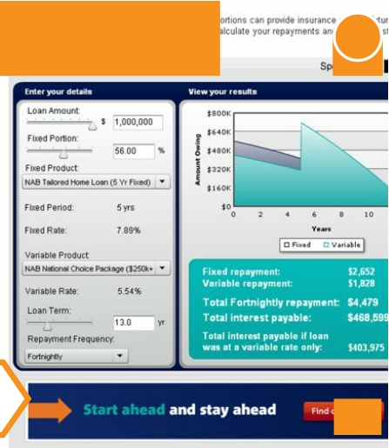
Simulation & feedforward
InI 3.ly/Inte
Can you give users a preview or simulation of the results of different actions or choices?
Interactive savings / loan simulat- ors such as this from Yahoo! are increasingly common, and can influence customer decisions
Design with Intent

Slide 40
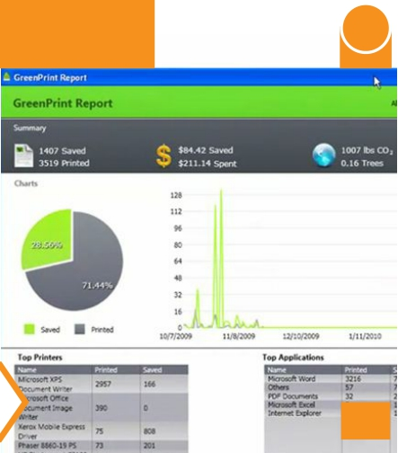
Summary feedback
InI 3.ly/Inte
Can you give users a report on what they’ve been doing, or
its effects?
GreenPrint, software that reduces wasted prints through better usability, provides users (and their bosses!) with a summary of resources saved
Design with Intent

Slide 41
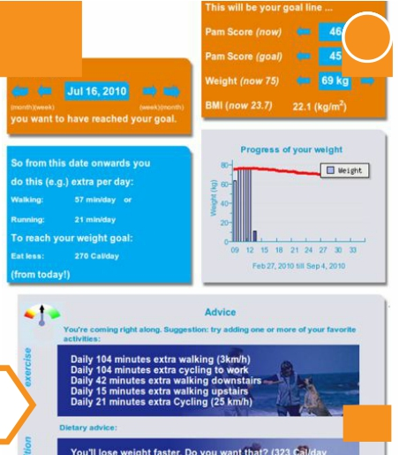
Tailoring
InI 3.ly/Inte
Could your system adapt what it offers to match individual users’ needs and abilities?
The Pam personal activity monitor suggests exercise regimes tailored to the user—something approaching the role of a ‘personal trainer’
Design with Intent

Slide 42
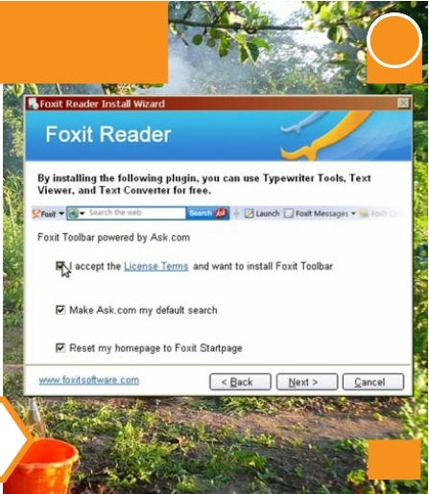
Tunnelling & wizards
InI 3.ly/Inte
Can you offer users a wizard to ‘tunnel’ them
through a decision process in the way you’d like?
This installation wizard tries to get users to ‘choose’ to install additional (and irrelevant) software by presenting them as default parts of the process
Design with Intent

Slide 43
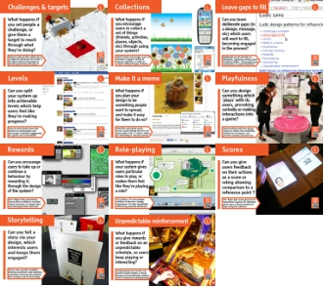
Ludic Lens
Games are great at engaging people for long periods of time, getting them involved, and influencing people’s behaviour through their very design. Yet this potential has (so far) been underexplored in application to other kinds of situations outside ‘recreation’.
The Ludic Lens includes a number of techniques for influencing user behaviour that can be derived from games and other ‘playful’ interactions, ranging from basic social psychology mechanisms such as goal-setting via challenges & targets, to operant conditioning via unpredictable reinforce- ment and rewards, to common game elements such as scores, levels and collections.
Images for Collections are screenshots of the University of Washington's UbiFit software, developed in collaboration with Intel Labs Seattle, available at http://dub.washington.edu/projects/ubifit
Images for Levels and Rewards are screenshots of Facebook/FarmVille and
AELI
3.ly/ludic
Image for Make it a meme is a screenshot of Regretsy’s story on
KPT5 software. Images for Playfulness and Role-playing are promotional photos kindly supplied by Steve Divnick (http://www.spiralwishingwells.com) and Tim Holley (http://timholley.de)
Gooseontheloose's chicken ponchos (http://www.regretsy.com/2009/10/20/
kentucky-frilled-chicken). Other photos/images by Dan Lockton. For references & further reading, please see 3.ly/ludic

Slide 44
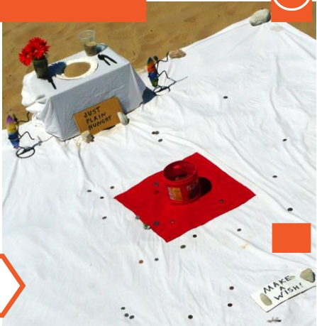
Challenges & targets
L
3.ly/Ludi
What happens if you set people a challenge, or give them a target to reach through what they’re doing?
Whoever laid out this coffee tub as a target for throwing coins knew a lot about influencing people to donate generously and enjoy it
Design with Intent

Slide 45
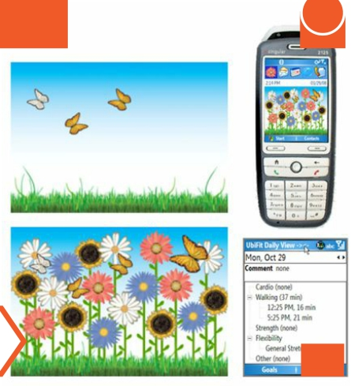
Collections
LuL 3.ly/Ludi
What happens if you encourage users to collect a set of things (friends, activities, places, objects, etc) through using your system?
UbiFit Garden encourages users to maintain a regular variety of exercise activities, in order to ‘collect’ different types of flower
Design with Intent

Slide 46
Leave gaps to fill
LuL 3.ly/Ludi
Can you leave deliberate gaps (in a design, message, etc) which users will want to fill, becoming engaged in the process?
Deliberate use of red links on Wikipedia, signifying articles which should be written, “encourage[s] new contributors in useful directions”
Design with Intent

Slide 47
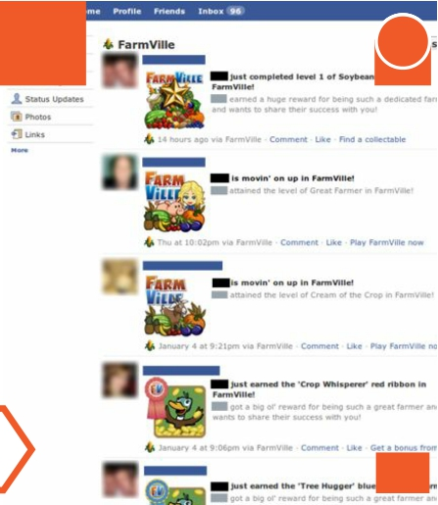
Levels
LuL 3.ly/Ludi
Can you split your system up into achievable levels which help users feel like they’re making progress?
Easy-to-reach levels lower the barriers to participation and encourage continued engagement for games such as FarmVille
Design with Intent

Slide 48
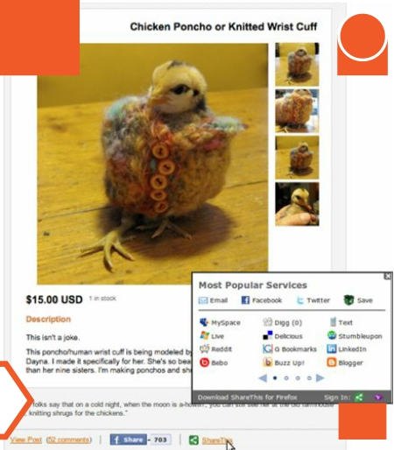
Make it a meme
LuL 3.ly/Ludi
What happens if you plan your design to be something people want to spread, and make it easy for them to do so?
ShareThis and similar quick- access social sharing services can
mean rapid ‘viral’ or ‘meme’ status for interesting or amusing stories
Design with Intent

Slide 49
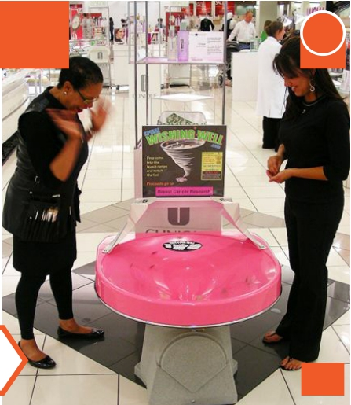
Playfulness
LuL 3.ly/Ludi
Can you design something which ‘plays’ with its users, provoking curiosity or making interactions into
a game?
Spiral wishing wells turn giving money to charity into something actively fun for donors, and provoke curiosity of passers-by
Design with Intent

Slide 50
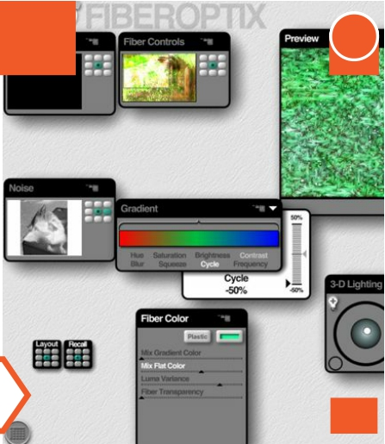
Rewards
LuL 3.ly/Ludi
Can you encourage users to take up or continue a behaviour by rewarding it, through the design of the system?
Kai’s Power Tools (pioneering visual effects software) revealed ‘bonus functions’ to reward users who developed their skill level
Design with Intent

Slide 51
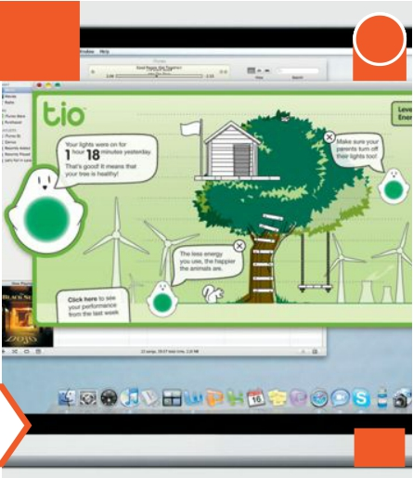
Role-playing
LuL 3.ly/Ludi
What happens if your system gives users particular roles to play, or makes them feel like they’re playing a role?
Tim Holley’s Tio encourages children to become ‘energy champions’ for their household, influencing parental behaviour
Design with Intent

Slide 52
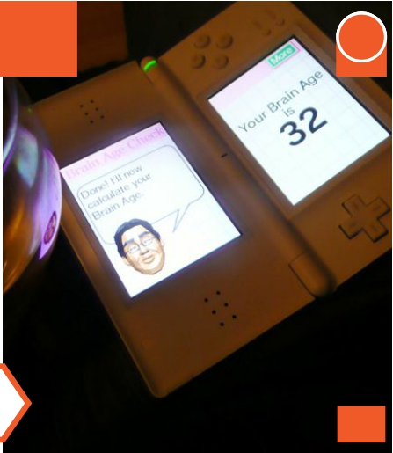
Scores
LuL 3.ly/Ludi
Can you give users feedback on their actions as a score or rating allowing comparison to a reference point ?
The ‘Brain Age’ score given by Dr Kawashima’s games for Nintendo gives users a clear incentive to keep using the software
Design with Intent

Slide 53
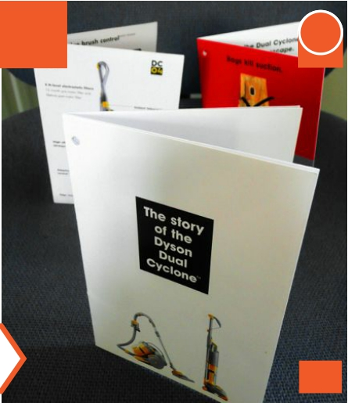
Storytelling
LuL 3.ly/Ludi
Can you tell a story via your design, which interests users and keeps them engaged?
Dyson uses narrative booklets drawing customers (and potential customers) into the story behind the company and its technology
Design with Intent

Slide 54
Unpredictable reinforcement
LuL 3.ly/Ludi
What happens if you give rewards or feedback on an unpredictable schedule, so users keep playing or interacting?
Arcade games such as this coin pusher usually employ a strong element of unpredictable reinforce- ment, to keep users playing/paying
Design with Intent

Slide 55
Perceptual Lens
The Perceptual Lens combines ideas from product semantics, semiotics, ecological psychology and Gestalt psychology addressing how users perceive patterns and meanings as they interact with the systems around them, and puts them into forms which invite the designer to think about how they might influence people’s behaviour. Most are predominantly visual, but they need not be: sounds, smells, textures and so on can all be used, individually or in combination.
These techniques may often applied by graphic and interaction designers in the course of a job or project without necessarily considering explicitly the influence thay can have on users’ perceptions and behaviour.
Images for Implied sequences and Nakedness are from Sludgegulper's and ITDP-Europe's Flickr streams, CC-BY-SA and CC-BY licensed respectively (http://www.flickr.com/photos/sludgeulper/4188746062 and http://www.flickr.com/photos/38607288@N03/3836906872).
Images for Metaphors, Mimicry & mirroring and Similarity are screenshots of Tipjar.com from the Wayback Machine, Eliza chatbot from http://nlp-addiction.com and a Microsoft Bing search.
Other photos by Dan Lockton
For references & further reading, please see 3.ly/perce
CPAELI
3.ly/perce

Slide 56
(A)symmetry
PeP 3.ly/Perc
Can you use symmetry to make elements look related, or asymmetry to show difference and focus attention?
The symmetrical holes on this lifebuoy, even without the text, suggest that it should be gripped with both hands simultaneously
Design with Intent

Slide 57
Colour associations
PeP 3.ly/Perc
Can you use colour to suggest associations between particular behaviours and outcomes?
This racecourse bookmaker’s key- board has a detailed language of colour-coded groups of functions, to aid rapid action-taking
Design with Intent

Slide 58
Contrast
P
3.ly/Perc
Can you create an obvious contrast between parts of your design or the context in which it's used?
In 2004, Britain’s Royal Mail switched to using red rubber bands for bundling post, to make them easier to spot if dropped accidentally
Design with Intent

Slide 59
Fake affordances
PeP 3.ly/Perc
Is there anything to be gained from making something look like it works one way, while actually doing something else
(or nothing at all)?
Many elevator/lift ‘door close’ buttons are reputedly ‘placebo buttons’, giving an illusion of control but not speeding up the process
Design with Intent

Slide 60
Implied sequences
PeP 3.ly/Perc
Can you make it look like there’s a sequence for users to follow, through the layout of elements?
This East German rail ticket machine makes very clear the order in which the interface should be used, with a sequential layout
Design with Intent

Slide 61
Metaphors
PeP 3.ly/Perc
Can you employ a metaphor / analogy of something familiar, so people understand or use your system the same way?
Tipjar.com, launched in the late 1990s, was one of the first simple micropayment systems, using the familiar metaphor of a tip jar
Design with Intent

Slide 62
Mimicry & mirroring
PeP 3.ly/Perc
Can your system mirror or mimic a user’s behaviour or mood in some way, to increase the engagement a user feels?
Chatbots have evolved beyond the classic ELIZA, and are being used in social engineering attacks to extract information and deliver malware
Design with Intent

Slide 63
Mood
PeP 3.ly/Perc
Can you use colour, images or other sensory stimuli to set a particular mood for a user’s interaction with your system?
Changes in hue, saturation and brightness can set moods: which room would you choose to stay in? (assuming the bed was made!)
Design with Intent

Slide 64
Nakedness
PeP 3.ly/Perc
Can you remove cues that people take for granted, to get them to think more about what they’re doing?
‘Naked roads’ with signage and markings removed can encourage pedestrians, cyclists and drivers to be more aware of each other’s presence
Design with Intent

Slide 65
Perceived affordances
PeP 3.ly/Perc
Can you design
the form of your system to suggest particular actions (or constraints on action) to users?
Reshaping the holes on bins to match the ‘form’ of different types of waste has been shown to increase recycling levels significantly
Design with Intent

Slide 66
Possibility trees
PeP 3.ly/Perc
Can you give people a ‘map’ of the routes or choices they can use to achieve different goals?
Presenting a simplified set of poss- ibilities, transport maps can influence users’ perceptions of geography, and promote certain routes over others
Design with Intent

Slide 67
Prominence
PeP 3.ly/Perc
Can you direct your users’ attention to what you want, by making it more prominent, obvious or exaggerated?
The ‘big red button’ is a common way of making a control prominent. Here on London’s DLR, it is recessed to help avoid accidental presses
Design with Intent

Slide 68
Proximity & grouping
PeP 3.ly/Perc
Can you group elements so that users perceive they have similar
functions or should be used together?
This power supply has controls often used in pairs (coarse & fine voltage adjustment, and output terminals) explicitly grouped
Design with Intent

Slide 69
Seductive atmospherics
PeP 3.ly/Perc
Can you use ambient sensory effects (sound, light, smell, etc) to encourage users to interact or behave in the way you’d like?
The distinctive ‘Subway smell’ may only be a by-product of baking, but intentional ‘scent branding’ is incr- easingly common in retail design
Design with Intent

Slide 70
Similarity
PeP 3.ly/Perc
Can you make elements look similar so users perceive them to share characteristics, or that they should be used together?
Paid-for links on Microsoft’s
Bing look very similar to the real search results, to increase the chance of users clicking them
Design with Intent

Slide 71
Transparency
PeP 3.ly/Perc
Can you (perhaps selectively) reveal what’s going on under the surface, to influence users’ perceptions and behaviour?
Dyson’s transparent dust container both demonstrates the vacuum cleaner’s effectiveness, and makes it likely to be emptied more often
Design with Intent

Slide 72
Watermarking
PeP 3.ly/Perc
Can you make a user feel like he or she (or someone else) ‘owns’ or has responsibility for something?
One UK shopkeeper writes custom- ers’ names on the packaging of snacks they buy, discouraging litter- ing through ‘taking ownership’
Design with Intent

Slide 73
Cognitive Lens
The Cognitive Lens draws on research in behavioural economics and cognitive psychology looking at how people make decisions, and how this is affected by ‘heuristics’ and ‘biases’. If designers understand how users make interaction decisions, that knowledge can be used to influence interaction behaviour. Equally, where users often make poor decisions, design can help counter this, although this may lead to a ‘we know what’s best for you’ attitude.
Dozens of cognitive biases and heuristics have been identified which could potentially be applied to design. The patterns detailed in these cards are some of the most commonly used; this selection draws particularly heavily on the work of Robert Cialdini, Dan Ariely, Richard Thaler and Cass Sunstein.
Images for Desire for Order and Personality are promotional photos from the Interactive Institute’s AWARE project (http://www.tii.se/aware/ designConcept.html) and Philips robotics (http://www.research.philips.com/ technologies/projects/robotics.html). Images for Decoys, Do as you’re told, Provoke empathy, Rephrasing & renaming and Social proof are screenshots of Magazines.com, the US DHS ESTA website, Twitterfall.com, Twitter.com and Amazon.co.uk respectively. Other photos by Dan Lockton.
For references & further reading, please see 3.ly/cogni
AECLI
3.ly/cogni

Slide 74
Assuaging guilt
C
3.ly/Cogn
Can you influence users by helping them reduce feelings of guilt about their behaviour?
This message both implies that one should feel bad about the ethics of coffee production, and offers an easy way to take away the guilt
Design with Intent

Slide 75
Commitment & consistency
CgC 3.ly/Cogn
Can you get users to commit to an idea or goal, so they feel they should behave consistently with this commitment?
In a 1976 study, householders sent a ‘We are saving oil’ sticker
subsequently used 10% less heating oil than groups not sent the sticker
Design with Intent

Slide 76
Decoys
CgC 3.ly/Cogn
Can you add ‘decoy’ choices, making the
others (which you want people to pick) look better in comparison?
Would you choose the $79.88 option here, when the other two offer you a free gift AND save you slightly more money?
Design with Intent

Slide 77
Desire for order
CgC 3.ly/Cogn
Can you use people’s desire for tidiness to influence them to
rearrange elements or take actions you want them to?
The AWARE Puzzle Switch, a light switch design by Loove Broms and Karin Ehrnberger, is visibly ‘disordered’ when in the ‘on’ position
Design with Intent

Slide 78
Do as you’re told
CgC 3.ly/Cogn
Can you use an authority figure or authoritative instruction to tell users what they should (or should not) do?
Impenetrable ‘agreements’ such as this often make heavy use of
authority (and threats) to reinforce their message: do as you’re told
Design with Intent

Slide 79
Emotional engagement
CgC 3.ly/Cogn
Can you design your system to engage people’s emotions, or make them emotionally connected to their behaviour?
The open beak of these ‘baby bird’ litter bins at a city farm (visited by lots of children) suggests that they are hungry and would like to be fed
Design with Intent

Slide 80
Expert choice
CgC 3.ly/Cogn
Is it possible to show users the choices that an expert or authority figure would make when in the same situation they’re in?
Endorsements where the celebrity is an ‘expert’ (such as chef Heston Blumenthal in this Waitrose campaign) can lend credibility
Design with Intent

Slide 81
Framing
CgC 3.ly/Cogn
Can you selectively present choices
in a way which frames the range available in a more positive light?
Starbucks’ drink sizes start with ‘tall’, framing the range further up the scale and avoiding any mediocre implications of ‘small’ or ‘medium’
Design with Intent

Slide 82
Habits
CgC 3.ly/Cogn
Can you make it easy for a new behaviour to become habitual, by building it into an existing routine?
Simply choosing to take the stairs rather than the lift / elevator can quickly become part of a daily routine at home or work
Design with Intent

Slide 83
Personality
CgC 3.ly/Cogn
Can you give your system a personality or character that engages users, becoming a ‘social actor’?
Dutch researchers have used Philips’ iCat robot to influence users’ decision- making with washing machines, advising and expressing opinions
Design with Intent

Slide 84
Provoke empathy
CgC 3.ly/Cogn
Can you help users see other people’s perspectives and thought processes, by revealing them through the design of your system?
Twitter, Facebook et al allow us to see at any moment the problems and concerns of millions of others just like us (or not) all over the world
Design with Intent

Slide 85
Reciprocation
CgC 3.ly/Cogn
Can you make users feel they’ve been done a favour (by the system, or by other users) and want to return it?
This busker’s postcards may be ‘free’, but the social norms of reciprocation mean most people will give him some tip in return
Design with Intent

Slide 86
Rephrasing & renaming
CgC 3.ly/Cogn
Can you rephrase or rename what you’d like users to do, so it aligns better with what they already want to do?
Twitter changed the name of the ‘Devices’ tab to the more easily understandable ‘Mobile’ to encourage more users to set up their phones
Design with Intent

Slide 87
Scarcity
CgC 3.ly/Cogn
Can you emphasise that a resource is valuable, limited in quantity, or
running out (or actually limit it artificially)?
We’re used to retailers emphasising that ‘everything must go’ and then not actually closing; in this case, however, the shop did close down
Design with Intent

Slide 88
Social proof
CgC 3.ly/Cogn
Can you show people what other users like them are doing in this situation, and which choices are most popular?
Amazon’s recommendations can be helpful to buyers by expanding
the scope of their knowledge, while increasing sales for Amazon
Design with Intent

Slide 89
Machiavellian Lens
The Machiavellian Lens comprises design patterns which, while diverse, all embody an ‘end justifies the means’ approach of the kind associated with Niccolò Machiavelli. These will often be considered unethical, but nevertheless are commonly used to control and influence consumers through pricing structures, planned obsolescence, lock-ins and so on, and are central to work by authors such as Vance Packard and Douglas Rushkoff, revealing the ‘hidden’ structures which shape our everyday behaviour. In technology contexts, Benjamin Mako Hill and Chris Nodder have both done great work exploring this area.
Elements of game theory are present in some of the patterns, and this is worth further investigation.
Image for Antifeatures & crippleware is from Orin Zebest's Flickr stream, CC-BY-SA licensed (http://www.flickr.com/photos/orinrobertjohn/68106611). Images for First one free, Forced dichotomy and Slow/no response are screenshots of Bill Moggridge’s ‘Designing Interactions’ website (http://www.designinginteractions.com/book), an example survey built using surveymonkey.com, and a registration form on the Univadis website (http://www.univadis.co.uk/medical_and_more/Registration?locale=en_GB) respectively. Other photos by Dan Lockton.
For references & further reading, please see 3.ly/machi
MCAELI
3.ly/machi

Slide 90
Anchoring Mv
3.ly/Mach
Can you affect users’ expectations or assumptions
by controlling the reference points they have?
Restaurant menus may use ‘anchor’ items: prominently placed, higher-priced dishes, raising what customers expect to be paying
Design with Intent

Slide 91
Antifeatures & crippleware Mv
3.ly/Mach
Can you deliberately disable some functions even though they’re still present, to drive users to upgrade, or to allow price discrimination?
Sony’s cheaper 60-minute MiniDiscs were identical to the 74-minute ones except for a pre-written portion of code preventing full use of the space
Design with Intent

Slide 92
Bundling Mv
3.ly/Mach
Can you include something you want users to do, along with something they want to do, so both get done?
Crushing up pills or tablets in a spoonful of peanut butter can be a good way to get dogs to take medi- cines they would otherwise refuse
Design with Intent

Slide 93
Degrading performance Mv
3.ly/Mach
Can you degrade the performance of a product or system until users comply with some behaviour change you want?
Some Nokia phones allegedly sense when a 3rd-party battery is used and switch into a high-power mode so it runs out more quickly
Design with Intent

Slide 94
First one free Mv
3.ly/Mach
Can you give something away which gets people interested or addicted, so they come back and pay for more?
Offering one chapter (often the introduction) free has become increasingly common as a way of promoting new books more widely
Design with Intent

Slide 95
Forced dichotomy Mv
3.ly/Mach
Can you configure a system so there is no ‘middle ground’ possible, and users must make a choice one way or the other?
An even-numbered (e.g. four- point) rating scale does not allow a ‘middle’ value: it forces respondents into making a ‘good or bad?’ choice
Design with Intent

Slide 96
Format lock-in/out
M
3.ly/Mach
Can you design your system so users become committed to a particular format or way of doing things?
Panasonic cameras include a ‘battery authentication’ system, which prevents using cheaper non-Panasonic replacements
Design with Intent

Slide 97
Functional obsolescence Mv
3.ly/Mach
Can you design things to become technologically superseded (or even wear out) quickly, so people replace them?
While new models do bring real technological advances, Apple has managed to create an ‘upgrade treadmill’ for iPhone buyers
Design with Intent

Slide 98
I cut, you choose Mv
3.ly/Mach
Can you structure a system so that no one user can get an advantage over others simply by being first to act?
If person 1 cuts a cake into halves, and person 2 chooses the half he or she wants, there is no advantage in person 1 cutting the cake unfairly
Design with Intent

Slide 99
Poison pill Mv
3.ly/Mach
Can you arrange things so that an otherwise attractive option has an unpleasant, self- defeating deterrent side-effect?
Security ink tags release indelible ink if removed incorrectly, in an attempt to make it simply not worth stealing the clothes
Design with Intent

Slide 100
Serving suggestion Mv
3.ly/Mach
Can you direct users to use a product or system in a particular way through examples or demonstrations?
Alka-Seltzer reputedly introduced the ‘two tablets per dose’ direction to users as part of a 1960s TV ad; before that, only one was taken
Design with Intent

Slide 101
Slow / no response Mv
3.ly/Mach
Can you get users to try different actions or repeat a behaviour by making the system respond or give feedback slowly?
Duplicate orders can be a problem where web forms are slow to submit and users click multiple times: this kind of instruction is common
Design with Intent

Slide 102
Style obsolescence Mv
3.ly/Mach
Can you design things to become unfashionable or undesirable quickly, to spur the desire for replacement or upgrades?
Fashions and trends are obvious in high-street retailing, but are also prevalent (and can be deliberately created) in other fields
Design with Intent

Slide 103
Worry resolution Mv
3.ly/Mach
Can you help users overcome worry about their
behaviour (perhaps after having suggested it in
the first place)?
The term ‘halitosis’ was allegedly introduced in a 1921 Listerine ad, part of a series making people worried about bad breath, then offering a solution
Design with Intent

Slide 104
Security Lens
The Security Lens represents a ‘security’ worldview, i.e. that undesired user behaviour is something to deter and/or prevent though ‘countermeasures’ designed into products, systems and environments, both physically and online, with examples such as digital rights management.
From a designer’s point of view, this can often be an ‘unfriendly’ – and in some circumstances unethical – view to take, effectively treating users as ‘guilty until proven innocent’. However, taking inspiration from the the patterns, it’s possible to think of ways that they could be applied to help users control their own habits or behaviour for their own benefit – encouraging exercise, reducing energy use, and so on.
Image for Sousveillance is a screenshot of TheyWorkForYou (http://www.theyworkforyou.com). Other photos/images by Dan Lockton, including photo of Mentor Teaching Machines textbook.
For references & further reading, please see 3.ly/secur
SAELI
3.ly/secur

Slide 105
Coercive atmospherics
SeS 3.ly/Secu
Can you use ambient sensory effects (sound, light, smell, etc) to make it harder for users to behave in certain ways?
Blue lighting is used in some pub- lic toilets (e.g. here, in Edinburgh) to discourage drug injection by making veins difficult to see
Design with Intent

Slide 106
Peerveillance
SeS 3.ly/Secu
What happens if users know (or believe) that what they’re doing is visible to their peers also using the system?
Neighbourhood Watch schemes are signed so that they provide a deterrent effect—”people here are vigilant about what’s going on”
Design with Intent

Slide 107
Sousveillance
SeS 3.ly/Secu
Can you give people ‘lower down’ a hierarchy the ability to observe and monitor the behaviour of
people above them?
TheyWorkForYou allows the public to monitor politicians’ activities easily: transparency leading to better accountability
Design with Intent

Slide 108
Surveillance
SeS 3.ly/Secu
What happens if users know (or believe) their behaviour is visible to or monitored by people in positions of power / authority?
CCTV is often presented as a
crime deterrent, influencing public behaviour, whether or not it is switched on or actually monitored
Design with Intent

Slide 109
Threat of injury
SeS 3.ly/Secu
What happens if your design threatens to (or actually does) harm users who behave in the ‘wrong’ way?
Spikes on walls—such as these stick-on plastic ones—can act as a deterrent to climbing or sitting, with varying effectiveness
Design with Intent

Slide 110
Threat to property
SeS 3.ly/Secu
What happens if your design threatens to damage users’ property if they use it the ‘wrong’ way?
‘Traffic control spikes’ are an attempt to enforce one-way traffic at entrances to car parks (etc): the threat is made very clear
Design with Intent

Slide 111
What you can do
SeS 3.ly/Secu
Can you give users different choices or access to functions depending on the capabilities they can demonstrate?
Child-proof lids are often used on containers for dangerous substances, such as medicines and garden and cleaning products
Design with Intent

Slide 112
What you have
SeS 3.ly/Secu
Can you give users
options or access
to different functions depending on their possession of a special tool, key, device or token?
Access cards allow the issuer to restrict entrance to certain buildings or areas to whoever has a card with the right permissions
Design with Intent

Slide 113
What you know
SeS 3.ly/Secu
Can you test what users know (information, passwords, etc) to give them access to different functions?
Remembering usernames, pass- words and answers to security ques- tions is increasingly part of our everyday lives, on- and offline
Design with Intent

Slide 114
What you’ve done
SeS 3.ly/Secu
Can you change the options available to users based on their current or previous behaviour?
‘Teaching machine’ textbooks allow students to progress in
different orders depending on which concepts need more explanation
Design with Intent

Slide 115
Where you are
SeS 3.ly/Secu
Can you make different choices available to users depending on their location?
Some supermarket trolleys have devices fitted to lock the wheels when taken outside a defined area, usually an adjacent car park
Design with Intent

Slide 116
Who or what you are
SeS 3.ly/Secu
Can you use criteria innate to particular individuals, groups or objects to block or make different options available?
Artificial height restrictors
attempt to allow only certain types of vehicles into a car park, by discriminating on vehicle height
Design with Intent

Slide 117
How you can help
I couldn’t have developed this toolkit without the help of an enormous number of people, who have offered ideas, comments and suggestions, as well as taking part in a series of workshops during 2008-10, trying out earlier iterations of Design with Intent.
The job isn’t finished, however: this is only v.1.0 of the toolkit, and I’m hoping to be able to revise and improve it in the years ahead, with expansion into other forms and a lot more evidence for which patterns work, in what circumstances, and why.
If you’d like to help, there are three main ways:
Surveys
At designwithintent.co.uk there are links to a number of different surveys designed to capture some of your impressions of using the cards, in different use situations (consultancy idea generation, workshop, educational project, etc). Your participation would be appreciated.
designwithintent.co.uk
Wiki
Each pattern (and each lens) has a corresponding wiki page, which, over time, with readers’ input, will (I hope) grow to include more examples, expansions of concepts, references, clarifications and discussion. The wiki also ought to allow new patterns to be identified and discussed.
designwithintent.co.uk
Share your examples
If you’ve got examples of design for behaviour change — either your own projects, or ones you’ve come across elsewhere — which you’re happy to share, please do get in touch. A Design with Intent book is planned, and it would be fantastic to feature reader submissions.
dan@danlockton.co.uk

Slide 118
Workshops, consultancy and research
If you find these Design with Intent cards useful, and think your organisation could benefit from a more detailed treatment of design and behaviour change, consider hiring Requisite Variety.
We provide consultancy at the interface between people and designed systems, across products, services and environments. We’ve recently run workshops for Philips Research and Jaguar Land Rover, and at the dConstruct 2011 and Interaction 12 conferences, and given internal talks for Ubisoft and Dyson.
Dan Lockton is the creator of the Design with Intent toolkit, and Requisite Variety is applying the insights and expertise developed through Dan’s ongoing academic research, together with an explicit ‘systems’ viewpoint, to practical contexts.
Please do get in touch for more information, or to discuss how we could work together: dan@requisitevariety.co.uk
1.0
Requisite Variety

